Slide 1

SEARCH STRATEGIES AND ALGORITHMS

Slide 2
Escaping Local Optima
"escaping local optima" means finding strategies to avoid getting stuck in solutions that are locally good but not globally optimal, which is a common challenge in complex optimization problems. Common techniques include introducing randomness, using diverse algorithms, and adjusting optimization parameters.

Slide 3
Given that It is difficult to define heuristic functions that are monotonic and well behaved
The alternative is to look for algorithms that can do better than Hill climbing
We look at another deterministic method next, and will look at randomized methods later
First we look at searching in the solution space or plan space

Slide 4
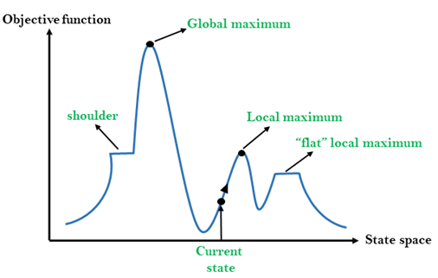
State-space Diagram for Hill Climbing

Slide 5
Random Walk Algorithm
A random walk can be defined as a series of discrete steps an object takes in some direction. Moreover, we determine the direction and movement of the object in each step probabilistically.
In mathematics and probability theory, a random work is a random process.
In a random walk, the future position is entirely independent of the current position of an object
Starting from a position, the object can go in any direction. Each step taken by the object in any direction has a probability associated with it. Hence, the final position is completely independent of the point of origin
The significant problem is finding a probability distribution function that can estimate the probability of the current position of an object after taking a random walk for a fixed amount of time.

Slide 6
A random walk is a mathematical process where an entity (often represented as a particle or a walker) moves randomly through a space.
Each step in the movement is determined by a probability distribution (e.g., flipping a coin, or a random number generator).
The movement can be in one dimension (like a number line), two dimensions (like a grid), or even in three or higher dimensions.
It's a fundamental concept in probability, statistics, and various areas of physics and computer science.

Slide 7
Consider the effect of random search moves.
• The consequence is that even from the same starting point, the search may proceed differently for different runs of the algorithm.
• A completely random procedure is the Random Walk in which the search process makes random moves in the search space in complete disregard of the gradient

Slide 8
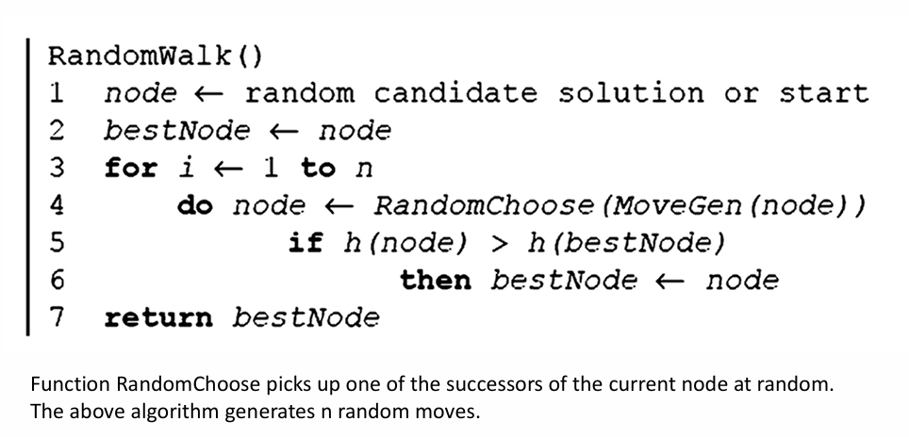
Algorithm

Slide 9
1. Start:
Place a marker at a starting point (e.g., position 0 on a number line).
2. Step: Flip a fair coin.
If the coin shows heads, move the marker one step to the right (e.g., from position 0 to 1).
If the coin shows tails, move the marker one step to the left (e.g., from position 0 to -1).
3. Repeat:
Continue flipping the coin and moving the marker in steps (1) and (2) repeatedly to create a "walk".
4. Termination:
Decide when to stop the walk (after a certain number of steps or when the walker reaches a specific position).

Slide 10
About Simulated Annealing Algorithm
A hill-climbing algorithm that never makes downhill moves towards states with lower value(or higher cost) is guaranteed to be incomplete, because it can get stuck on a local maximum.
In contrast, a purely random walk-that is moving to a successor chosen uniformly at randomly from the set of successors-is complete, but extremely inefficient.
Therefore, it is necessary to combine Hill Climbing and Random Walk to achieve both completeness and efficiency. Simulated annealing is such an algorithm.

Slide 11
Simulated Annealing
Simulated Annealing is an optimization algorithm designed to search for an optimal or near-optimal solution in a large solution space.
The name and concept are derived from the process of annealing in metallurgy, where a material is heated and then slowly cooled to remove defects and achieve a stable crystalline structure

Slide 12
Simulated Annealing is an algorithm that combines the two tendencies, explorative and exploitative, of the two search methods (Hill Climbing and Random Walk).
The algorithm makes a probabilistic move in a random direction.
The probability of making the move is proportional to the gain of the value made by the move
Physically gain is associated with energy2 and deltaE represents the change in the evaluation value.

Slide 13
The larger the gain, the larger is the probability of making the move
The algorithm will make a move even for negative gain moves with nonzero probability
The algorithm will make a move even for negative gain moves with nonzero probability (even though this probability decreases as the move becomes worse).

Slide 14
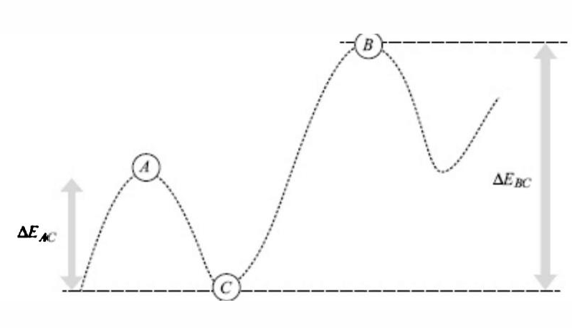
Simulated Annealing
To move from A to C, the algorithm has to Incur a smaller loss than to move from B to C. Simulated Annealing Algorithm is more likely to move from A to C to B than vice versa.
Given a series of local maxima, the search, over a period of time, will move towards the better ones.

Slide 15
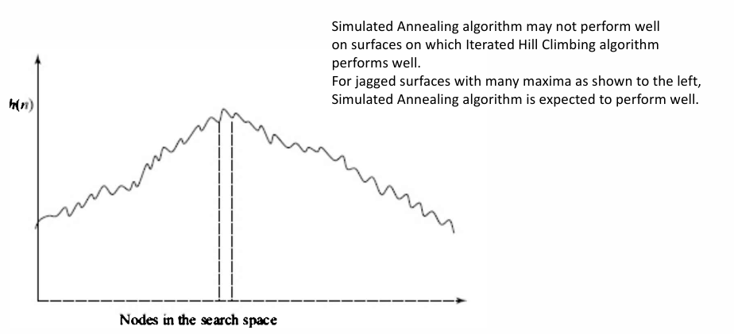

Slide 16
Genetic Algorithms
Genetic Algorithms(GAs) are adaptive heuristic search algorithms that belong to the larger part of evolutionary algorithms.
Genetic algorithms are based on the ideas of natural selection and genetics.
These are intelligent exploitation of random searches provided with historical data to direct the search into the region of better performance in solution space.
They are commonly used to generate high-quality solutions for optimization problems and search problems
Genetic algorithms simulate the process of natural selection which means those species that can adapt to changes in their environment can survive, reproduce and go to the next generation.

Slide 17
Each generation consists of a population of individuals and each individual represents a point in search space and possible solution.
Each individual is represented as a string of character/integer/float/bits
Foundation of Genetic Algorithms
Each chromosome indicates a possible solution. Thus the population is a collection of chromosomes.
A fitness function characterizes each individual in the population. Therefore, greater fitness better is the solution.
Out of the available individuals in the population, the best individuals are used to reproduce the next generation offsprings.
The offspring produced will have features of both the parents and is a result of mutation. A mutation is a small change in the gene structure.

Slide 18
Population based methods
This section considers algorithms that maintain multiple assignments. The first method, beam search, maintains the best k assignments.
The next algorithm, stochastic beam search, selects which assignments to propagate stochastically.
In genetic algorithms, which are inspired by biological evolution, the k assignments forming a population interact in various ways to produce the new population.
In these algorithms, a total assignment of a value to each variable is called an individual and the set of current individuals is a population.

Slide 19
Example: Eight Queen’s problem
The goal of the 8-queens problem is to place eight queens on a chessboard such that no queen attacks any other. (A queen attacks any piece in the same row, column or diagonal.)
There are two main kinds of formulation:
An incremental formulation involves operators that augment the state description, starting with an empty state; for the 8-queens problem, this means that each action adds a queen to the state.

Slide 20
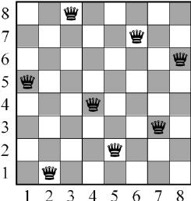
A complete-state formulation starts with all 8 queens on the board and moves them around. In either case, the path cost is of no interest because only the final state counts. The first incremental formulation one might try is the following:
States: Any arrangement of 0 to 8 queens on the board is a state.
Initial state: No queens on the board.
Actions: Add a queen to any empty square.
Transition model: Returns the board with a queen added to the specified square.
Goal test: 8 queens are on the board, none attacked.

Slide 21
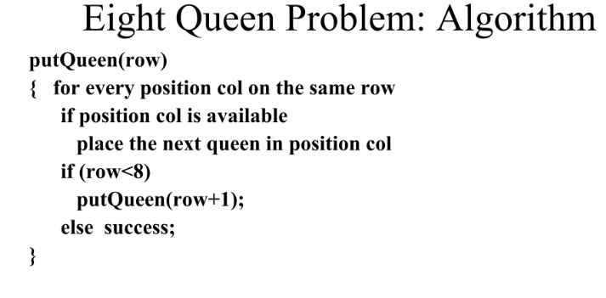

Slide 22
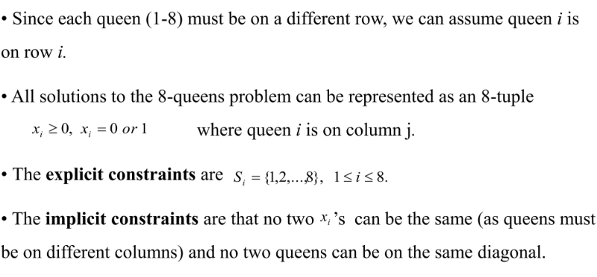
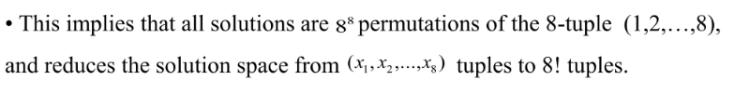
Eight Queen’s Problem

Slide 23
Emergent Systems
The Process of emergent complex systems by putting together the basic set of simple parts and then letting “nature do the rest”. These efforts to mimic life in the field of Artificial life.
Cliff & Grand in 1999 – 2001, the authors adopts a ‘bottom-up’ approach of putting together artificial creatures.
The fact that systems of simple elements can come together to display complex behavior was illustrated by the British mathematician John Conway in a cellular automaton known as Conway’s Game of Life.
The Game of life is played on an infinite two-dimensional grid of cells, each of which can be in one of two states dead or alive.
There are two simple rules for life and death:
Cells that are alive will continue to live if they have exactly two or three living cells in their neighborhood. Otherwise they die of loneliness(less than two neighbors around ) or overcrowding (more than three neighbors alive).
Cell that are dead are born again if they are surrounded by exactly three living cells

Slide 24

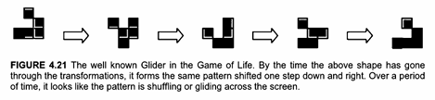

Slide 25
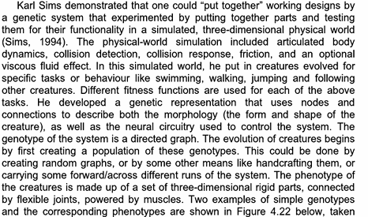

Slide 26
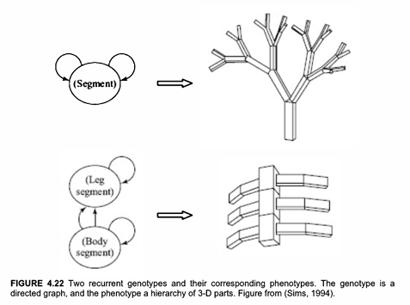

Slide 27



Slide 28
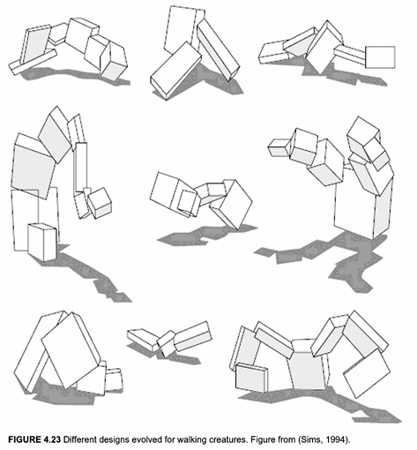

Slide 29
Application to TSP
The main application of TSP arises in real scenario as it is capable to handle multiple salesman. These situations arise mostly in various routing and scheduling problems. Some reported applications in literature are presented below.
1. Printing press scheduling problem: One of the major and primary applications of the TSP arises in scheduling a printing press for a periodical with multi-editions. Here, there exist five pairs of cylinders between which the paper rolls and both sides of a page are printed simultaneously. There exist three kind of forms, namely 4-, 6- and 8-page forms, which are used to print the editions. The scheduling problem consists of deciding which form will be on which run and the length of each run.
2. School bus routing problem: (Angel et al., 1972) investigated the problem of scheduling buses as a variation of the TSP with some side constraints. The objective of the scheduling is to obtain a bus loading pattern such that the number of routes is minimized, the total distance travelled by all buses is kept at minimum, no bus is overloaded and the time required to traverse any route does not exceed a maximum allowed policy.

Slide 30
3. Crew scheduling problem: An application for deposit carrying between different branch banks is reported by (Svestka & Huckfeldt, 1973). Here, deposits need to be picked up at branch banks and returned to the central office by a crew of messengers. The problem is to determine the routes having a total minimum cost.
4. Interview scheduling problem: (Gilbert & Hofstra, 1992) found the application of TSP, having multiperiod variations, in scheduling interviews between tour brokers and vendors of the tourism industry. Each broker corresponds to a salesman who must visit a specified set of vendor booths, which are represented by a set of T cities.
5. Hot rolling scheduling problem: In the iron and steel industry, orders are scheduled on the hot rolling mill in such a way that the total set-up cost during the production can be minimized.
6. Design of global navigation satellite system surveying networks: A very recent and an interesting application of the TSP, as investigated by (Saleh & Chelouah, 2004) arises in the design of global navigation satellite system (GNSS) surveying networks. A GNSS is a space-based satellite system which provides coverage for all locations worldwide and is quite crucial in real-life applications such as early warning and management for disasters, environment and agriculture monitoring, etc

Slide 31
Overview of Concepts of Ant Colony Optimization
Ant Colony (-based) Optimisation – a way to solve optimisation problems based on the way that ants indirectly communicate directions to each other.
Inspiration: ACO is inspired by the foraging behavior of real ant colonies. Ants deposit chemical substances on the ground as they travel, and the intensity of chemical substances influences the paths chosen by other ants. Over time, shorter paths accumulate more pheromones, leading to the discovery of optimal routes.
Application: ACO has been successfully applied to combinatorial optimization problems, such as the traveling salesman problem, job scheduling, and network routing.

Slide 32

A living bridge

Slide 33

Co-operative carrying

Slide 34
Emergent property of many individuals operating simple rules
forming bridges
sorting brood and food items
cooperating in carrying large items
finding shortest route from nest to food source
The ACO algorithm is inspired by the above point

Slide 35
Ant Colony Optimisation Algorithms: Basic Ideas
Ants are agents that:
Move along between nodes in a graph.
They choose where to go based on pheromone strength (and maybe other things)
An ant’s path represents a specific candidate solution.
When an ant has finished a solution, pheromone is laid on its path, according to quality of solution.
This pheromone trail affects behaviour of other ants by `stigmergy’ …

Slide 36
Pheromone Trails
Individual ants lay pheromone trails while travelling from the nest, to the nest or possibly in both directions.
The pheromone trail gradually evaporates over time.
But pheromone trail strength accumulate with multiple ants using path.
_{Nest}
_{Food source}

Slide 37
E.g. A 4-city TSP
Initially, random levels of pheromone are scattered on the edges
A
B
D
Pheromone
C
AB: 10, AC: 10, AD, 30, BC, 40, CD 20
Ant

Slide 38
E.g. A 4-city TSP
An ant is placed at a random node
A
B
D
Pheromone
C
AB: 10, AC: 10, AD, 30, BC, 40, CD 20
Ant

Slide 39
E.g. A 4-city TSP
The ant decides where to go from that node,
based on probabilities
calculated from:
- pheromone strengths,
- next-hop distances.
Suppose this one chooses BC
A
B
D
Pheromone
C
AB: 10, AC: 10, AD, 30, BC, 40, CD 20
Ant

Slide 40
E.g. A 4-city TSP
The ant is now at C, and has a `tour memory’ = {B, C} – so he cannot
visit B or C again.
Again, he decides next hop
(from those allowed) based
on pheromone strength
and distance;
suppose he chooses
CD
A
B
D
Pheromone
C
AB: 10, AC: 10, AD, 30, BC, 40, CD 20
Ant

Slide 41
E.g. A 4-city TSP
The ant is now at D, and has a `tour memory’ = {B, C, D}
There is only one place he can go now:
A
B
D
Pheromone
C
AB: 10, AC: 10, AD, 30, BC, 40, CD 20
Ant

Slide 42
E.g. A 4-city TSP
So, he has nearly finished his tour, having gone over the links:
BC, CD, and DA.
A
B
D
Pheromone
C
AB: 10, AC: 10, AD, 30, BC, 40, CD 20
Ant

Slide 43
E.g. A 4-city TSP
So, he has nearly finished his tour, having gone over the links:
BC, CD, and DA. AB is added to complete the round trip.
A
B
Now, pheromone on the tour
is increased, in line with the
fitness of that tour.
D
Pheromone
C
AB: 10, AC: 10, AD, 30, BC, 40, CD 20
Ant

Slide 44
E.g. A 4-city TSP
A
B
Next, pheromone everywhere
is decreased a little, to model
decay of trail strength over
time
D
Pheromone
C
AB: 10, AC: 10, AD, 30, BC, 40, CD 20
Ant

Slide 45
E.g. A 4-city TSP
We start again, with another ant in a random position.
A
B
Where will he go?
Next , the actual algorithm
and variants.
D
Pheromone
C
AB: 10, AC: 10, AD, 30, BC, 40, CD 20
Ant

Slide 46
The ACO algorithm for the TSP
We have a TSP, with n cities.
1. We place some ants at each city. Each ant then does this:
It makes a complete tour of the cities, coming back to its starting city, using a transition rule to decide which links to follow. By this rule, it chooses each next-city at random, but biased partly by the pheromone levels existing at each path, and biased partly by heuristic information.
2. When all ants have completed their tours.
Global Pheromone Updating occurs.
The current pheromone levels on all links are reduced (I.e. pheromone levels decay over time).
Pheromone is lain (belatedly) by each ant as follows: it places pheromone on all links of its tour, with strength depending on how good the tour was.
Then we go back to 1 and repeat the whole process many times, until we reach a termination criterion.

Slide 47
The transition rule
T(r,s) is the amount of pheromone currently on the path that goes
directly from city r to city s.
H(r,s) is the heuristic value of this link – in the classic TSP
application, this is chosen to be 1/distance(r,s) -- I.e. the shorter
the distance, the higher the heuristic value.
is the probability that ant k will choose the link that goes
from r to s
is a parameter that we can call the heuristic strength
The rule is:
Where our ant is at city r, and s is a city as yet unvisited on its
tour, and the summation is over all of k’s unvisited cities

Slide 48
Global pheromone update
A_{k}(r,s) is amount of pheromone added to the (r, s) link by ant k.
m is the number of ants
is a parameter called the pheromone decay rate.
L_{k} is the length of the tour completed by ant k
T(r, s) at the next iteration becomes:
Where

Slide 49
SAT - Boolean satisfiability
The Boolean satisfiability or SAT problem.
We are given a formula containing binary variables that are connected by logical relations such as OR and AND.
We aim to establish whether there is any way to set these variables so that the formula evaluates to true.
Algorithms that are applied to this problem are known as SAT solvers.
Boolean operators
Boolean operators are standard functions that take one or more binary variables as input and return a single binary output. Hence, they can be defined by truth tables in which we enumerate every combination of inputs and define the output for each (figure 1). Common logical operators include:

Slide 50
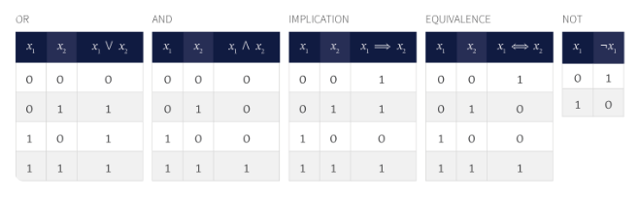

Slide 51
The OR operator is written as ∨ and takes two inputs 𝑥1 and 𝑥2. It returns true if one or both of the inputs are true and returns false otherwise.
The AND operator is written as ∧ and takes two inputs 𝑥1 and 𝑥2. It returns true if both the inputs are true and false otherwise.
The IMPLICATION operator is written as ⇒ and evaluates whether the two inputs are consistent with the statement ‘if 𝑥1 then 𝑥2’. The statement is only disobeyed when 𝑥1 is true and 𝑥2 is false and so implication returns false for this combination of inputs and true otherwise.
The EQUIVALENCE operator is written as ⇔ and takes two inputs 𝑥1 and 𝑥2. It returns true if the two inputs are the same and returns false otherwise.
The NOT operator is written as ¬ and takes one input. It returns true if the input 𝑥1 is false and vice-versa. We refer ¬𝑥1 as the complement of 𝑥1.

Slide 52
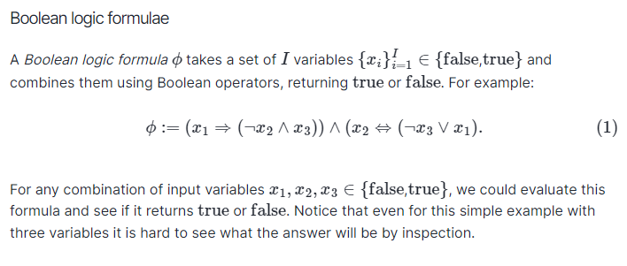

Slide 53
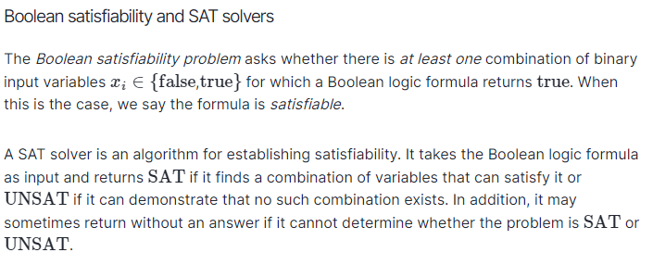

Slide 54
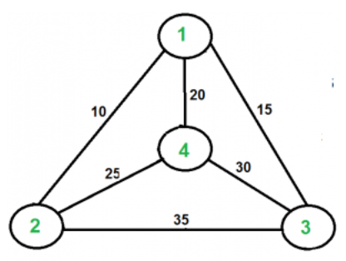
Traveling Salesman Problem (TSP)
Given a set of cities and distances between every pair of cities, the problem is to find the shortest possible route that visits every city exactly once and returns to the starting point.
For example, consider the graph shown in the figure on the right side. A TSP tour in the graph is 1-2-4-3-1. The cost of the tour is 10+25+30+15 which is 80.
Output of Given Graph:
minimum weight Hamiltonian Cycle :
10 + 25 + 30 + 15 := 80

Slide 55
Consider city 1 as the starting and ending point. Since the route is cyclic, we can consider any point as a starting point.
Generate all (n-1)! permutations of cities.
Calculate the cost of every permutation and keep track of the minimum cost permutation.
Return the permutation with minimum cost.

Slide 56
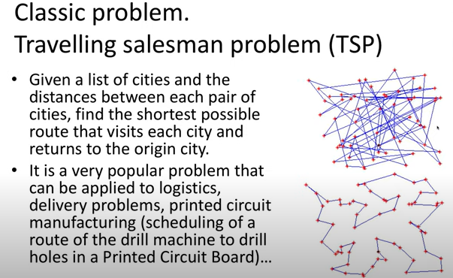

Slide 57
Finding Optimal Paths: Branch & Bound, A*
The Branch and Bound Algorithm is a method used in combinatorial optimization problems to systematically search for the best solution.
It works by dividing the problem into smaller sub problems, or branches, and then eliminating certain branches based on bounds on the optimal solution.
This process continues until the best solution is found or all branches have been explored.
Branch and Bound is commonly used in problems like the traveling salesman and job scheduling.

Slide 58
Branch and bound is an effective solution to some problems
It is appropriate to use a branch and bound approach if the given problem is discrete optimization. Discrete optimization refers to problems in which the variables belong to the discrete set. Examples of such problems include 0-1 Integer Programming and Network Flow problems.
When it comes to combinatory optimization problems, branch and bound work well. An optimization problem is optimized by combinatory optimization by finding its maximum or minimum based on its objective function. The combinatory optimization problems include Boolean Satisfiability and Integer Linear Programming.

Slide 59
Basic Concepts of Branch and Bound
Generation of a state space tree:
As in the case of backtracking, B&B generates a state space tree to efficiently search the solution space of a given problem instance.
In B&B, all children of an E-node in a state space tree are produced before any live node gets converted in an E-node. Thus, the E-node remains an E-node until i becomes a dead node.
Evaluation of a candidate solution:
Unlike backtracking, B&B needs additional factors evaluate a candidate solution:
A way to assign a bound on the best values of the given criterion functions to each node in a state space tree: It is produced by the addition of further components to the partial solution given by that node.
The best values of a given criterion function obtained so far: It describes the upper bound for the maximization problem and the lower bound for the minimization problem.

Slide 60
A feasible solution is defined by the problem states that satisfy all the given constraints.
An optimal solution is a feasible solution, which produces the best value of a given objective function.
Bounding function :
It optimizes the search for a solution vector in the solution space of a given problem instance.
It is a heuristic function that evaluates the lower and upper bounds on the possible solutions at each node. The bound values are used to search the partial solutions leading to an optimal solution. If a node does not produce a solution better than the best solution obtained thus far, then it is abandoned without further exploration.
The algorithm then branches to another path to get a better solution. The desired solution to the problem is the value of the best solution produced so far.

Slide 61
The reasons to dismiss a search path at the current node :
The bound value of the node is lower than the upper bound in the case of the maximization problem and higher than the lower bound in the case of the minimization problem. (i.e. the bound value of the subnode is not better than the value of the best solution obtained until that node).
The node represents infeasible solutions, violation of the constraints of the problem.
The node represents a subset of a feasible solution containing a single point. In this case, if the latest solution is better than the best solution obtained so far the best solution is modified to the value of a feasible solution at that node.

Slide 62
Types of Branch and Bound Solutions:
The solution of the Branch and the bound problem can be represented in two ways:
Variable size solution: Using this solution, we can find the subset of the given set that gives the optimized solution to the given problem. For example, if we have to select a combination of elements from {A, B, C, D} that optimizes the given problem, and it is found that A and B together give the best solution, then the solution will be {A, B}.
Fixed-size solution: There are 0s and 1s in this solution, with the digit at the ith position indicating whether the ith element should be included, for the above example, the solution will be given by {1, 1, 0, 0}, here 1 represent that we have select the element which at ith position and 0 represent we don’t select the element at ith position.

Slide 63
Classification of Branch and Bound Problems:
The Branch and Bound method can be classified into three types based on the order in which the state space tree is searched.
FIFO Branch and Bound
LIFO Branch and Bound
Least Cost-Branch and Bound

Slide 64
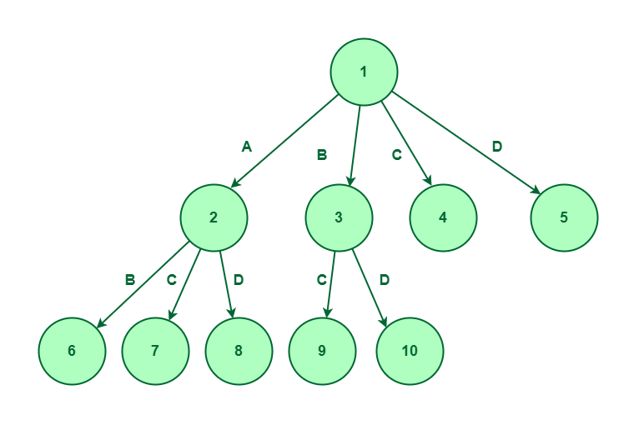
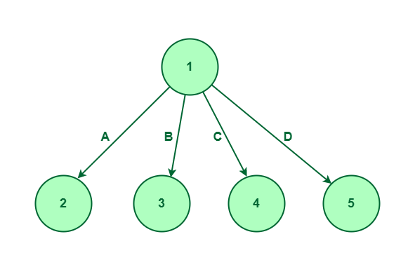
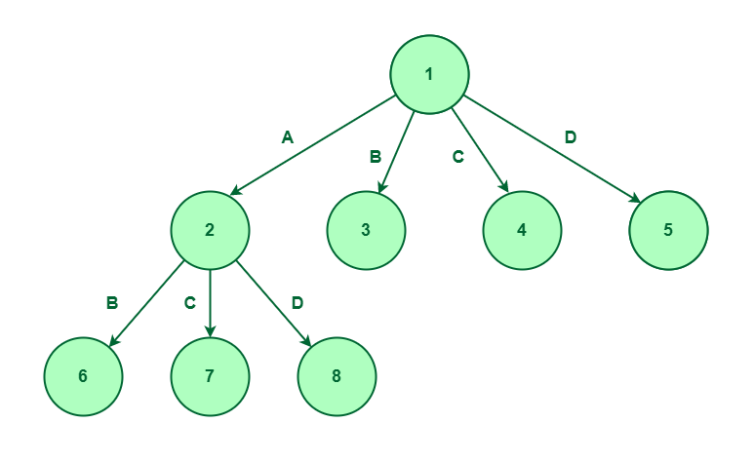
1. FIFO Branch and Bound (Queue)
First-In-First-Out is an approach to the branch and bound problem that uses the queue approach to create a state-space tree. In this case, the breadth-first search is performed, that is, the elements at a certain level are all searched, and then the elements at the next level are searched, starting with the first child of the first node at the previous level.
For a given set {A, B, C, D}, the state space tree will be constructed as follows : BFS – exploring nodes
State Space tree for set {A, B, C, D}
Considered element B and not considered element A
Selecting element A

Slide 65
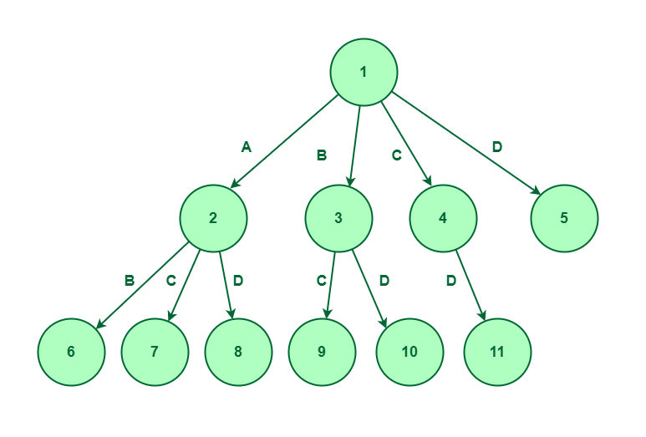
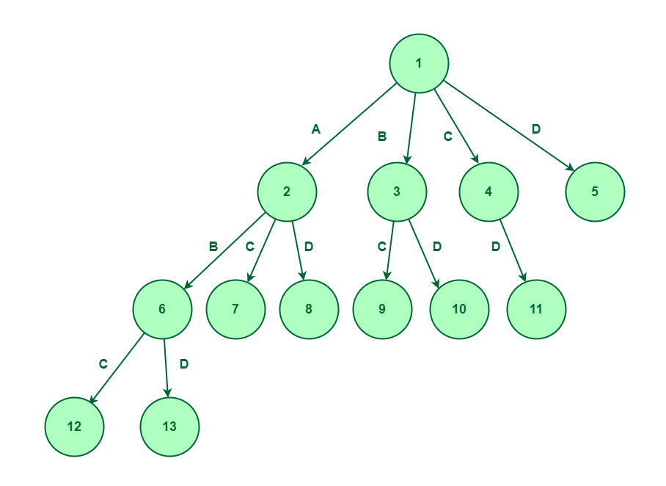
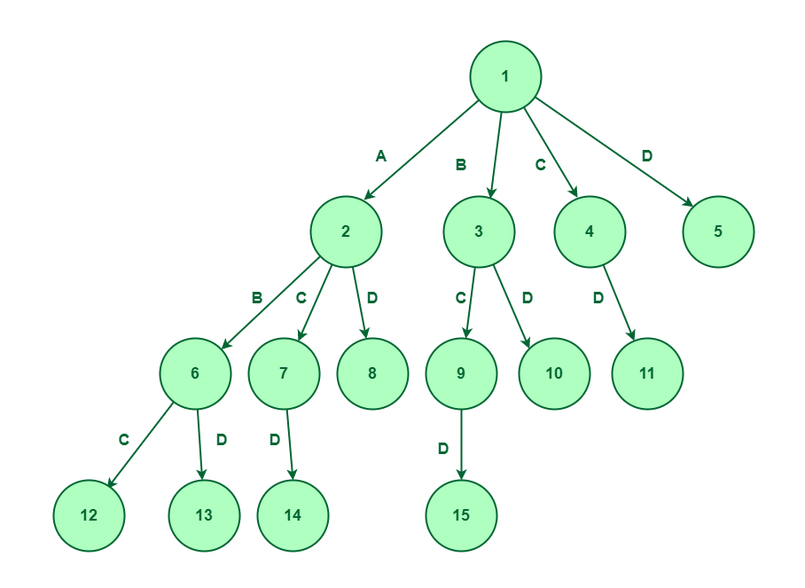
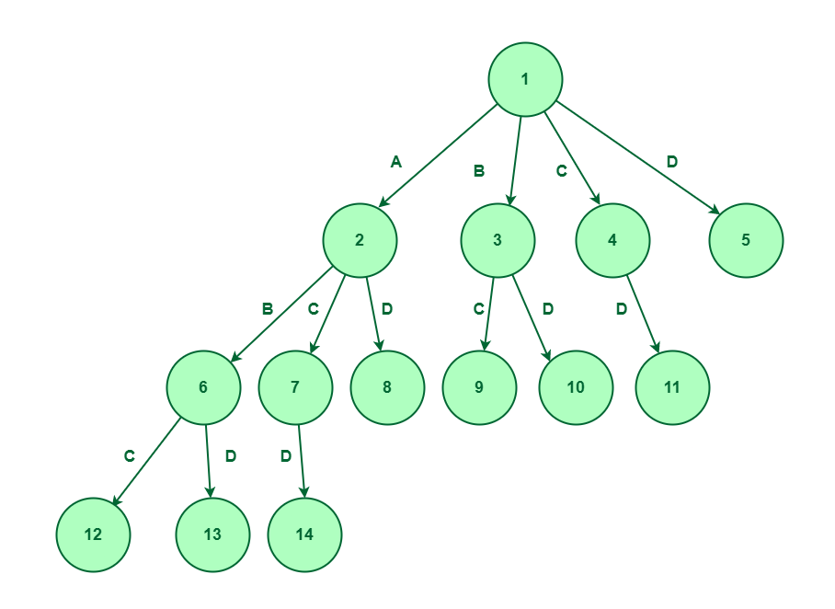
Expand node 6
Considered elements C and not considered elements A and B
Expand node 7
Expand node 9

Slide 66
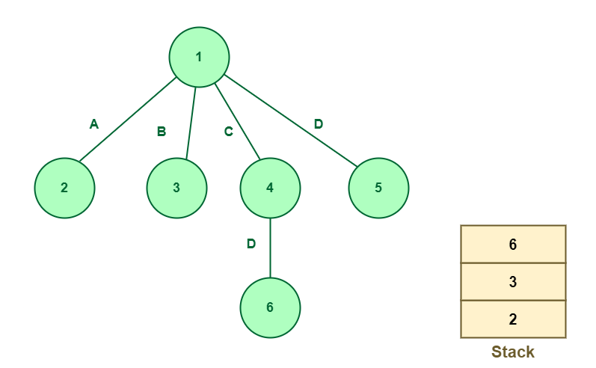
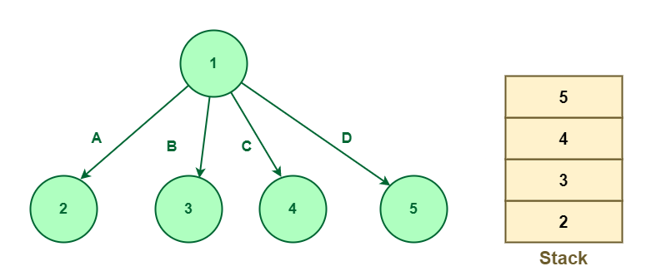
2. LIFO Branch and Bound (Stack)
The Last-In-First-Out approach for this problem uses stack in creating the state space tree. When nodes are added to a state space tree, they are added to a stack. After all nodes of a level have been added, we pop the topmost element from the stack and explore it.
For a given set {A, B, C, D}, the state space tree will be constructed as follows :
State space tree for element {A, B, C, D}
Expand node 4

Slide 67
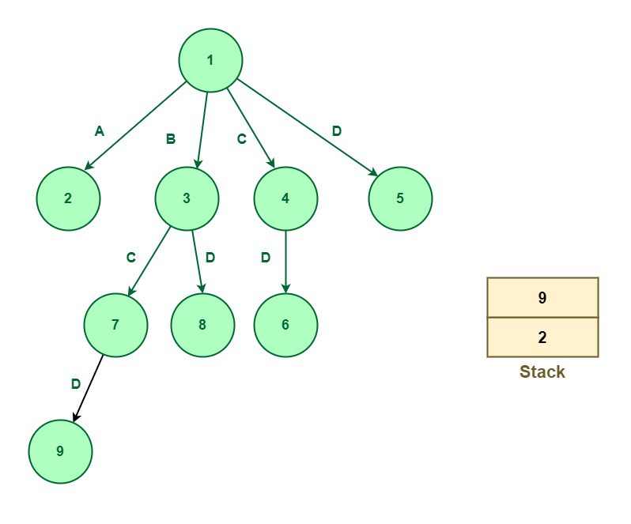
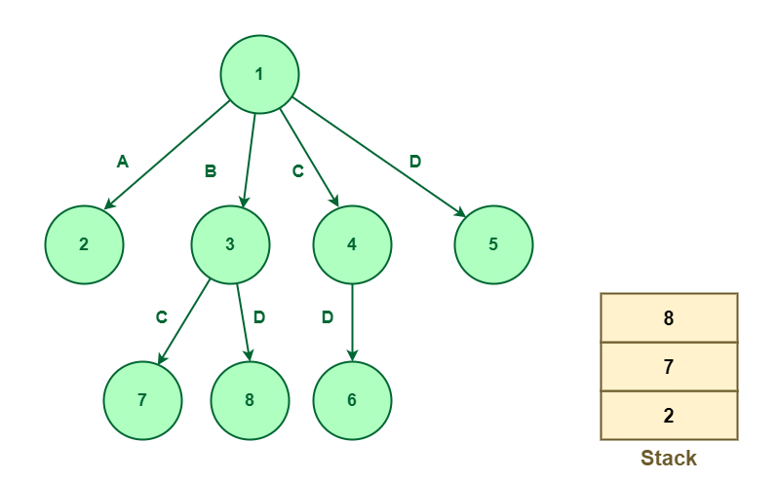
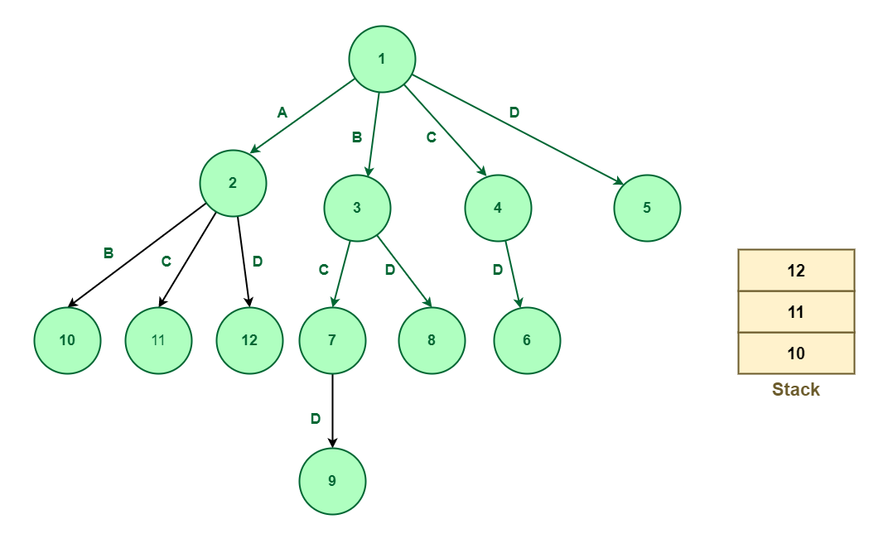
Expand node 3
Expand node 7
Expand node 2

Slide 68
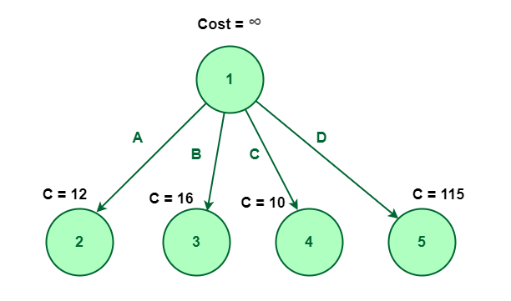
3. Least Cost-Branch and Bound
To explore the state space tree, this method uses the cost function. The previous two methods also calculate the cost function at each node but the cost is not been used for further exploration.
In this technique, nodes are explored based on their costs, the cost of the node can be defined using the problem and with the help of the given problem, we can define the cost function. Once the cost function is defined, we can define the cost of the node.
Let’s first consider node 1 having cost infinity shown below:
In the following diagram, node 1 is expanded into four nodes named 2, 3, 4, and 5.
Node 1 is expanded into four nodes named 2, 3, 4, and 5

Slide 69
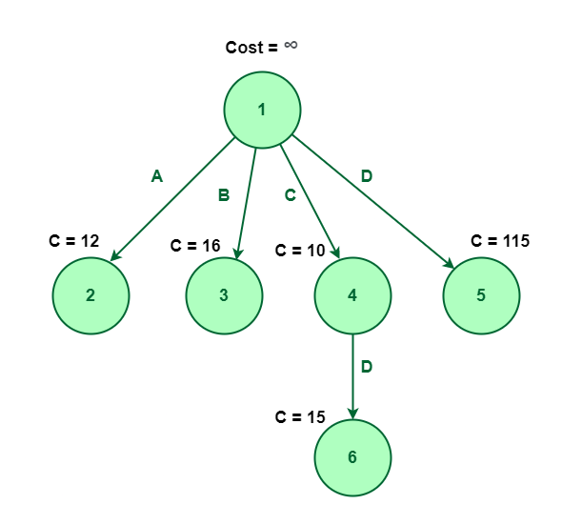
Assume that cost of the nodes 2, 3, 4, and 5 are 12, 16, 10 and 115 respectively.
In this method, we will explore the node which is having the least cost. In the above figure, we can observe that the node with a minimum cost is node 4. So, we will explore node 4 having a cost of 10.
During exploring node 4 which is element C, we can notice that there is only one possible element that remains unexplored which is D (i.e, we already decided not to select elements A, and B). So, it will get expanded to one single element D, let’s say this node number is 6.
Now, Node 6 has no element left to explore. So, there is no further scope for expansion.
Hence the element {C, D} is the optimal way to choose for the least cost.
Exploring node 4 which is element C

Slide 70
Advantages of Branch and Bound Algorithm:
Don’t explore all the nodes in a branch and bound algorithm. Due to this, the branch and the bound algorithm have a lower time complexity than other algorithms.
The problem is small and the branching can be completed in a reasonable amount of time, the algorithm finds an optimal solution.
By using the branch and bound algorithm, the optimal solution is reached in a minimal amount of time. When exploring a tree, it does not repeat nodes.
Disadvantages of Branch and Bound Algorithm:
It takes a long time to run the branch and bound algorithm.
In the worst-case scenario, the number of nodes in the tree may be too large based on the size of the problem.

Slide 71
A* algorithm
A* (pronounced "A-star") is a powerful graph traversal and path finding algorithm widely used in artificial intelligence and computer science.
It is mainly used to find the shortest path between two nodes in a graph, given the estimated cost of getting from the current node to the destination node.
The main advantage of the algorithm is its ability to provide an optimal path by exploring the graph in a more informed way compared to traditional search algorithms such as Dijkstra's algorithm.

Slide 72
The main idea of A* is to evaluate each node based on two parameters:
g(n): the actual cost to get from the initial node to node n. It represents the sum of the costs of node n outgoing edges.
h(n): Heuristic cost (also known as "estimation cost") from node n to destination node n.
This problem-specific heuristic function must be acceptable, meaning it never overestimates the actual cost of achieving the goal.
The evaluation function of node n is defined as
f(n) = g(n)+h(n).

Slide 73
Algorithm A* selects the nodes to be explored based on the lowest value of f(n), preferring the nodes with the lowest estimated total cost to reach the goal.
The A* algorithm works:
Create an open list of found but not explored nodes.
Create a closed list to hold already explored nodes.
Add a starting node to the open list with an initial value of g
Repeat the following steps until the open list is empty or you reach the target node:
Find the node with the smallest f-value (i.e., the node with the minor g(n) h(n)) in the open list.
Move the selected node from the open list to the closed list.
Create all valid descendants of the selected node.

Slide 74
For each successor, calculate its g-value as the sum of the current node's g value and the cost of moving from the current node to the successor node. Update the g-value of the tracker when a better path is found.
If the follower is not in the open list, add it with the calculated g-value and calculate its h-value. If it is already in the open list, update its g value if the new path is better.
Repeat the cycle. Algorithm A* terminates when the target node is reached or when the open list empties, indicating no paths from the start node to the target node.
The A* search algorithm is widely used in various fields such as robotics, video games, network routing, and design problems because it is efficient and can find optimal paths in graphs or networks.

Slide 75
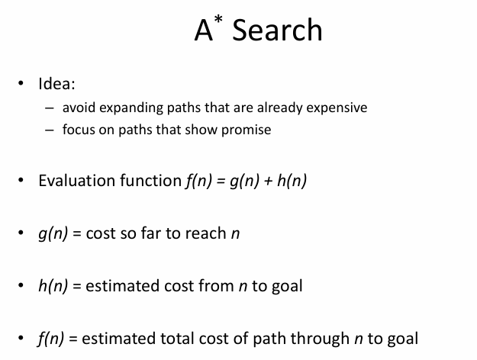

Slide 76
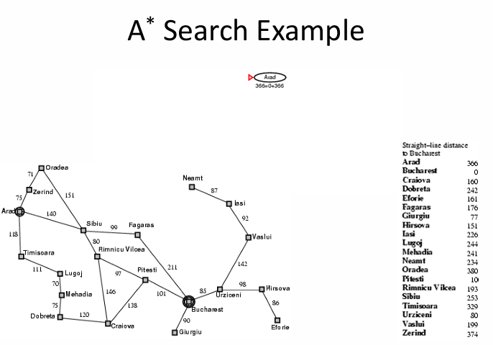

Slide 77
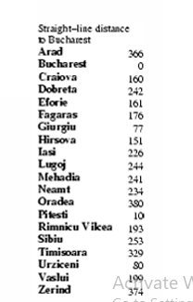

Slide 78
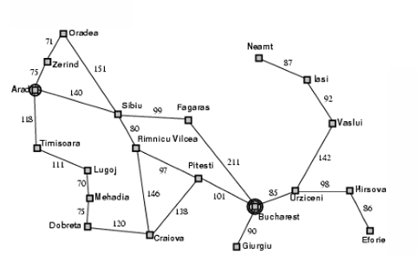

Slide 79
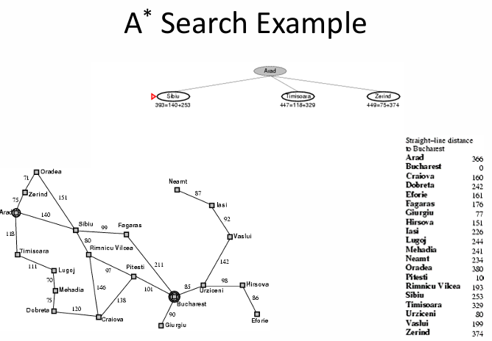

Slide 80
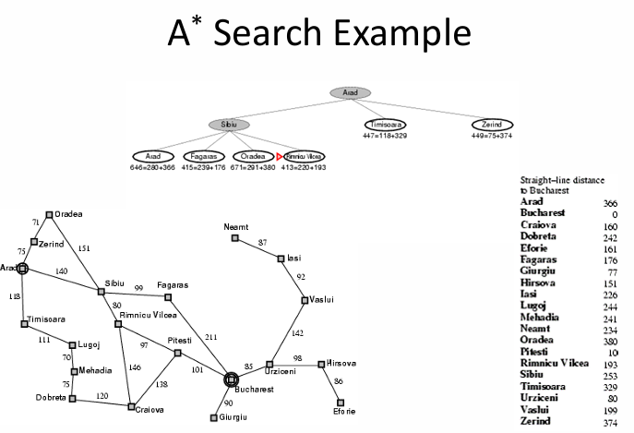

Slide 81
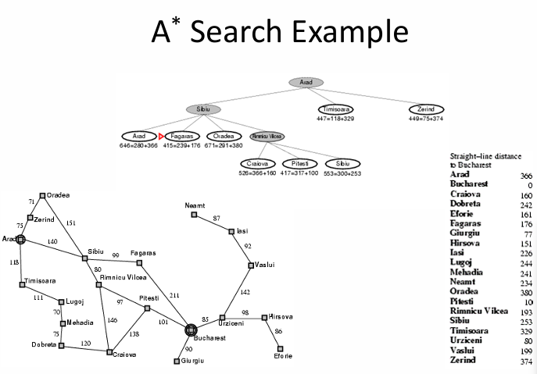

Slide 82
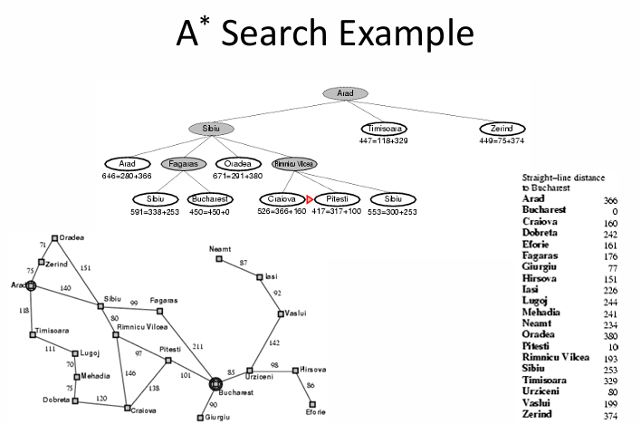

Slide 83
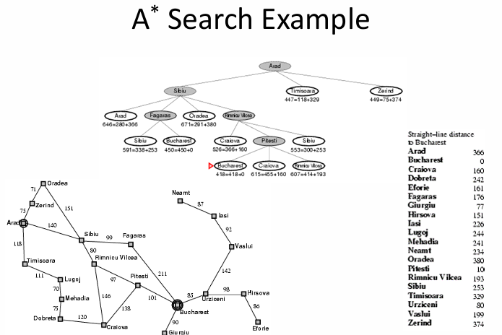

Slide 84
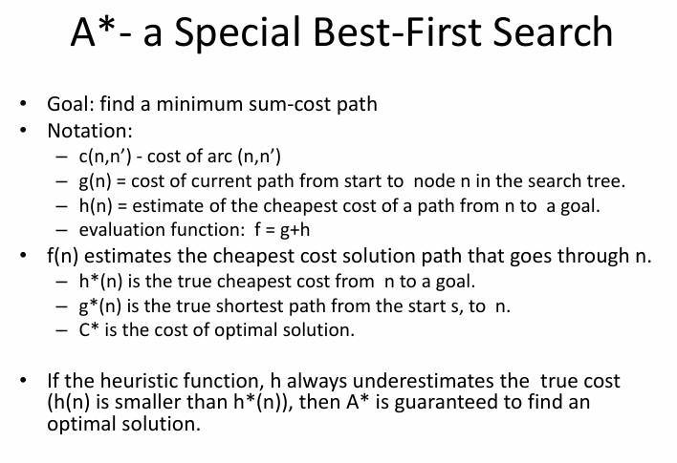

Slide 85
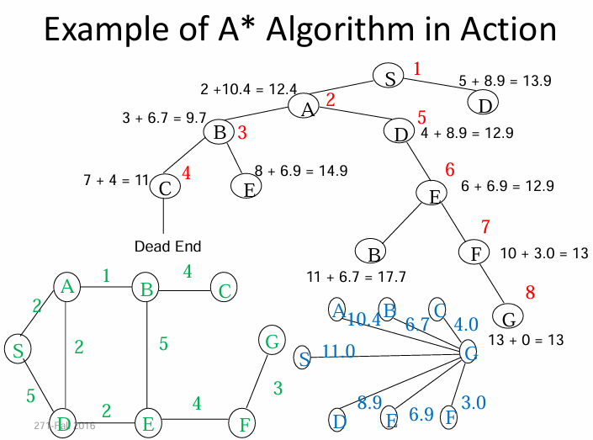

Slide 86
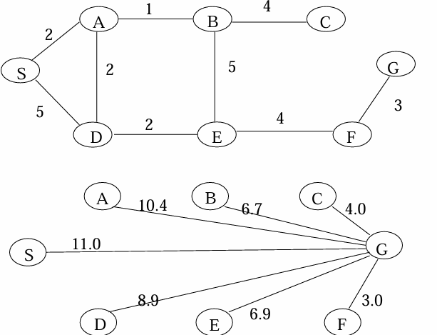

Slide 87
Advantages
Optimal solution: A* ensures finding the optimal (shortest) path from the start node to the destination node in the weighted graph given an acceptable heuristic function. This optimality is a decisive advantage in many applications where finding the shortest path is essential.
Completeness: If a solution exists, A* will find it, provided the graph does not have an infinite cost This completeness property ensures that A* can take advantage of a solution if it exists.
Efficiency: A* is efficient if an efficient and acceptable heuristic function is used. Heuristics guide the search to a goal by focusing on promising paths and avoiding unnecessary exploration, making A* more efficient than non-aware search algorithms such as breadth-first search or depth-first search.
Versatility: A* is widely applicable to various problem areas, including way finding, route planning, robotics, game development, and more. A* can be used to find optimal solutions efficiently as long as a meaningful heuristic can be defined.

Slide 88
Disadvantages
Heuristic accuracy: The performance of the A* algorithm depends heavily on the accuracy of the heuristic function used to estimate the cost from the current node to the If the heuristic is unacceptable (never overestimates the actual cost) or inconsistent (satisfies the triangle inequality), A* may not find an optimal path or may explore more nodes than necessary, affecting its efficiency and accuracy.
Memory usage: A* requires that all visited nodes be kept in memory to keep track of explored paths. Memory usage can sometimes become a significant issue, especially when dealing with an ample search space or limited memory resources.
Time complexity: Although A* is generally efficient, its time complexity can be a concern for vast search spaces or graphs. In the worst case, A* can take exponentially longer to find the optimal path if the heuristic is inappropriate for the problem.
Bottleneck at the destination: In specific scenarios, the A* algorithm needs to explore nodes far from the destination before finally reaching the destination region. This the problem occurs when the heuristic needs to direct the search to the goal early effectively.

Slide 89
Cost Binding: A* faces difficulties when multiple nodes have the same f-value (the sum of the actual cost and the heuristic cost). The strategy used can affect the optimality and efficiency of the discovered path. If not handled correctly, it can lead to unnecessary nodes being explored and slow down the algorithm.
Complexity in dynamic environments: In dynamic environments where the cost of edges or nodes may change during the search, A* may not be suitable because it does not adapt well to such changes. Reformulation from scratch can be computationally expensive, and D* (Dynamic A*) algorithms were designed to solve this
Perfection in infinite space : A* may not find a solution in infinite state space. In such cases, it can run indefinitely, exploring an ever-increasing number of nodes without finding a solution. Despite these shortcomings, A* is still a robust and widely used algorithm because it can effectively find optimal paths in many practical situations if the heuristic function is well-designed and the search space is manageable. Various variations and variants of A* have been proposed to alleviate some of its limitations.

Slide 90
Applications of the A* Search Algorithm
Path finding in Games: A* is often used in video games for character movement, enemy AI navigation, and finding the shortest path from one location to another on the game map. Its ability to find the optimal path based on cost and heuristics makes it ideal for real-time applications such as games.
Robotics and Autonomous Vehicles: A* is used in robotics and autonomous vehicle navigation to plan an optimal route for robots to reach a destination, avoiding obstacles and considering terrain costs. This is crucial for efficient and safe movement in natural environments.
Maze solving: A* can efficiently find the shortest path through a maze, making it valuable in many maze-solving applications, such as solving puzzles or navigating complex structures.
Route planning and navigation: In GPS systems and mapping applications, A* can be used to find the optimal route between two points on a map, considering factors such as distance, traffic conditions, and road network topology.

Slide 91
Puzzle-solving: A* can solve various diagram puzzles, such as sliding puzzles, Sudoku, and the 8-puzzle problem. Resource Allocation: In scenarios where resources must be optimally allocated, A* can help find the most efficient allocation path, minimizing cost and maximizing efficiency.
Network Routing: A* can be used in computer networks to find the most efficient route for data packets from a source to a destination node.
Natural Language Processing (NLP): In some NLP tasks, A* can generate coherent and contextual responses by searching for possible word sequences based on their likelihood and relevance.
Path planning in robotics: A* can be used to plan the path of a robot from one point to another, considering various constraints, such as avoiding obstacles or minimizing energy consumption.
Game AI: A* is also used to make intelligent decisions for non-player characters (NPCs), such as determining the best way to reach an objective or coordinate movements in a team-based game.

Slide 92
Admissible A*
The heuristic function h(n) is called admissible if h(n) is never larger than h*(n), namely h(n) is always less or equal to true cheapest cost from n to the goal.
• A* is admissible if it uses an admissible heuristic, and h(goal) = 0.
• If the heuristic function, h always underestimates the true cost (h(n) is smaller than h*(n)), then A* is guaranteed to find an optimal solution

Slide 93
Informed Heuristic Functions
Informed search, as opposed to uninformed search, utilizes additional information to guide the search process efficiently.
The information comes from heuristic functions, which provide estimates of the cost or value of states in the search space.
Informed search algorithms aim to reach the goal state while minimizing the computational effort and exploring more promising paths early in the search.

